Slide 1
Satellite Image Classification with Computer Vision and Machine Learning
Peter Ilhardt

Slide 2
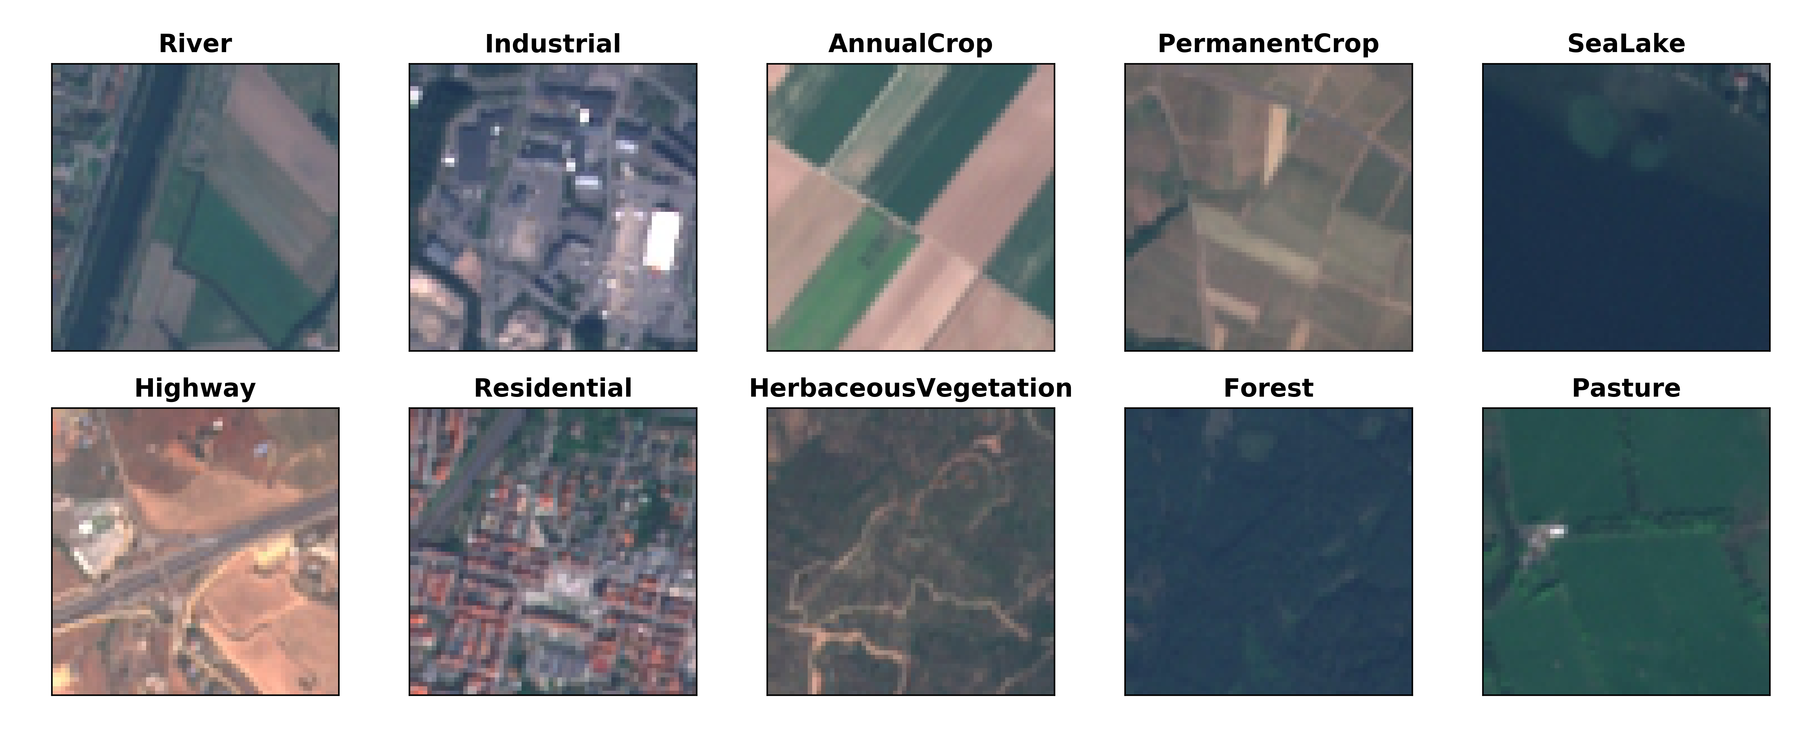
Objective: Correctly Predict the Land Cover Category of a New Satellite Image

Slide 3
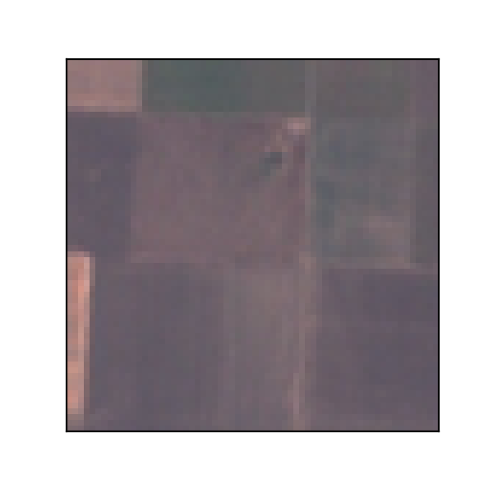
Modeling Pipeline
Image
Processing
Dimensionality
Reduction
Model
Fitting
2
3
2
7
1
7
9
2
3
7
1
7
9
7
4
2
4
9
4
2
1
5
5
6
1
5
5
6
3
1
6
3
2
8
3
1
3
9
2
8
3
9
8
1
9
6
5
7
1
3
9
6
5
7
1
3

Slide 4
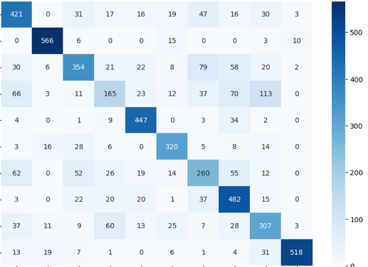
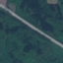
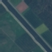
Best Model Confuses Line Objects
Highway
True
Class
River
0
Accuracy = 71%
Predicted Class
Notes:
Say I didn’t show labels right away- one axis actual, one predicted (labels?)

Slide 5
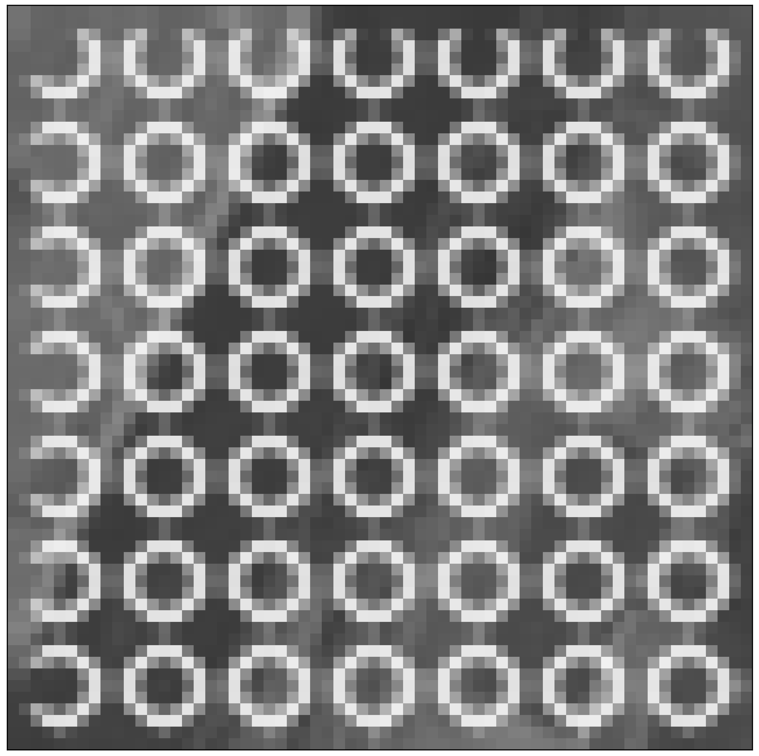
Modeling Pipeline
Image
Processing
Local Feature Extraction
Dimensionality
Reduction
Model
Fitting

Slide 6
Scale-Invariant Feature Transform (SIFT)

Slide 7
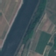
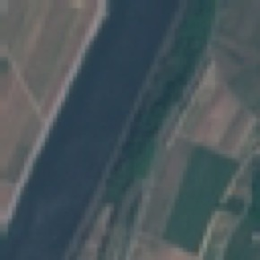
Local Feature Descriptors Improve Classification
Accuracy = 81%

Slide 8
Modeling Pipeline
Image
Processing
Local Feature Extraction
Ensemble
Learning
Dimensionality
Reduction
Model
Fitting

Slide 9
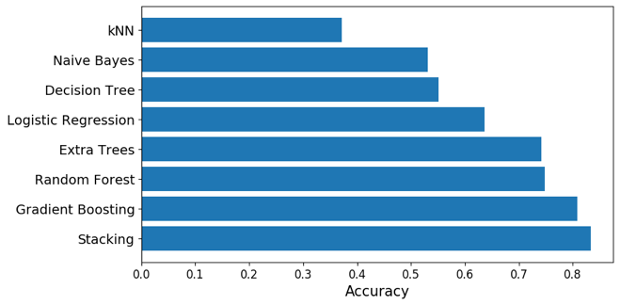
Ensemble Methods Leverage Strengths of Weak Learners to Generate Strong Learner
Simple
Models
Ensemble
Methods

Slide 10
Conclusions
Feature extraction and dimensionality reduction improve modelling with high-dimensional data (e.g. images, text)
Accounting for feature interrelatedness (e.g. spatial, temporal) significantly boosts accuracy
Many models are better than one

Slide 11


Thank You
Peter Ilhardt
pilhardt@gmail.com
(630) 430-1590
/in/peterilhardt/
/peterilhardt

Slide 12
Appendix

Slide 13
Satellite Imagery: Detecting Land Use Change Over Time

Slide 14
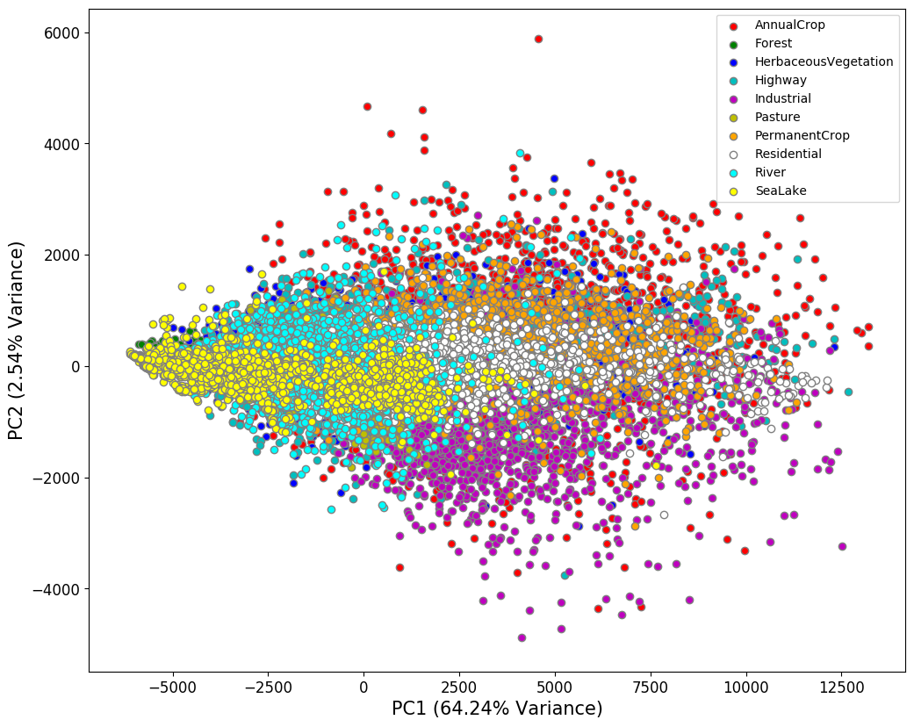
Principal Components Analysis Reduces Dimensions while Preserving Differences

Slide 15
+
+
Ergul, 2009

